Slide 1
Majorization-Minimization Algorithms in Signal Processing, Communications, and Machine Learning
Gwangwoo Kim
Oct. 26, 2023

Slide 2
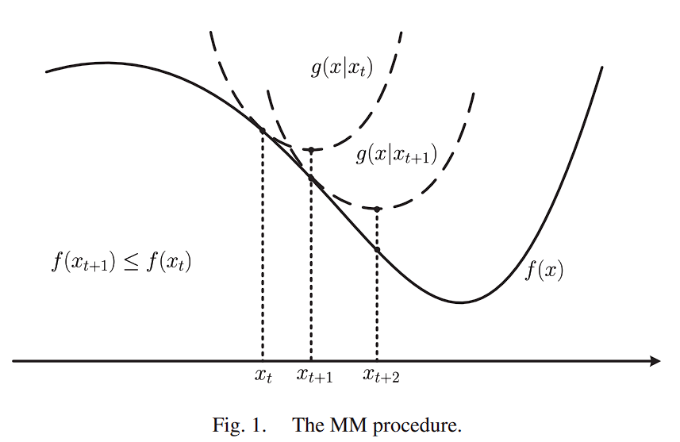
Introduction
Separability in variables (parallel computing)
Convexity and smoothness
The existence of a closed-form minimizer

Slide 3
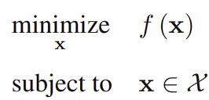




Algorithmic Framework
Consider
Assume f is continuous and goes to infinity as x goes to infinity.
The algorithm generates a sequence of points {xt}
Suppose we have a continuous surrogate function
Choose a next point with
(Principle)

Slide 4
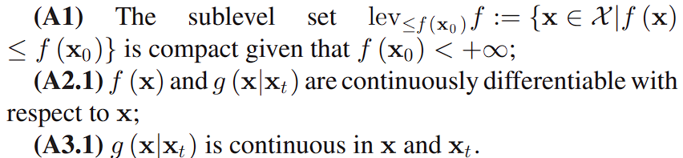

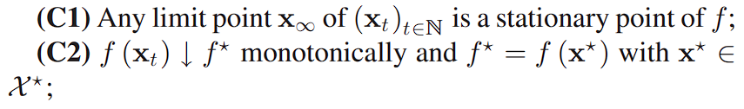
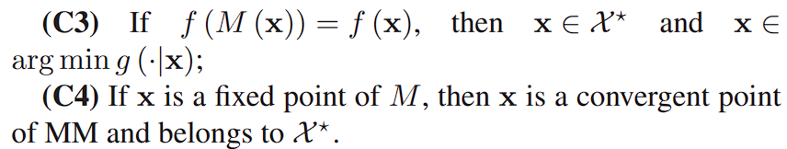
Unconstrained Optimization
Assumptions
Stationary point
Basic results

Slide 5
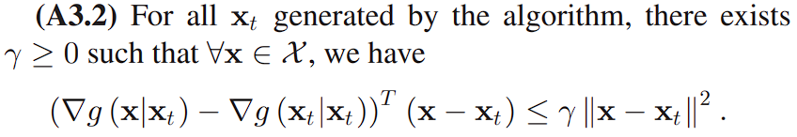

Constrained Optimization with Smooth Objective Function
Assumptions
f is continuously differentiable
Stationary point

Slide 6

Constrained Optimization With Non-Smooth Objective Function
Assumptions
f and g are nonsmooth, but their directional derivatives exist for all feasible directions
Stationary point
Convergence

Slide 7
Acceleration Schemes
A drawback of MM is that it can suffer from a slow convergence speed.

Slide 8

First Order Taylor Expansion
Suppose f can be decomposed as
Because
We have

Slide 9


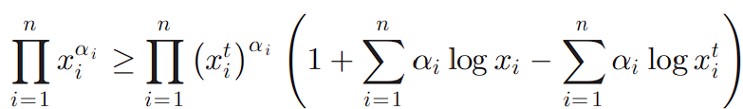
First Order Taylor Expansion
Example 1:
Example 2 (iteratively reweighted least squares ): For 0<p<=1,
Example 3:
It is proved by applying Example 1.
K. Lange and H. Zhou, “MM algorithms for geometric and signomial programming,” Math. Program., vol. 143, nos. 1/2, pp. 339–356, 2014.

Slide 10
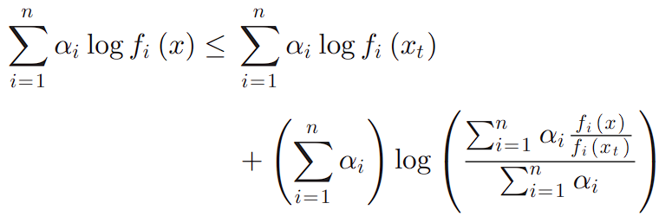
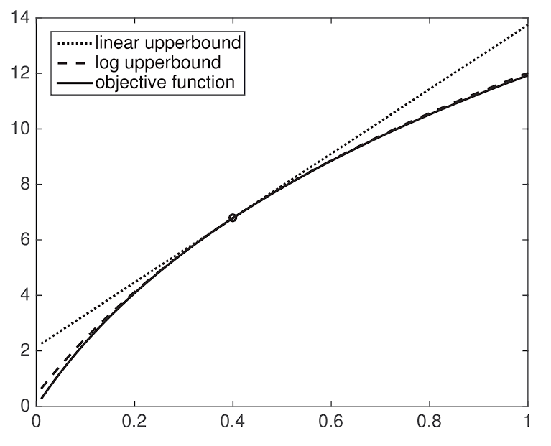
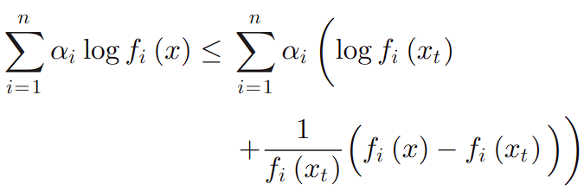
Convexity Inequality
Example 4 (Jensen’s Inequality): We will later see EM is a special case of MM.
Example 5:
Cf. (Example 1)

Slide 11
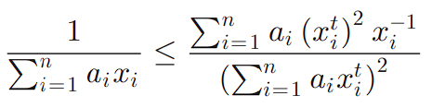
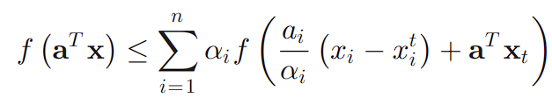
Convexity Inequality
Example 6: convexity of 1/x gives
Example 7: For a convex function f
If a and xt are positive, it was proposed in medical imaging.
D. R. Hunter and K. Lange, “A tutorial on MM algorithms,” Am. Statist., vol. 58, no. 1, pp. 30–37, 2004.

Slide 12
Omitted upper bounds
Construction by Second Order Taylor Expansion
Arithmetic-Geometric Mean Inequality
Cauchy-Schwartz Inequality
Schur Complement
Generalization

Slide 13


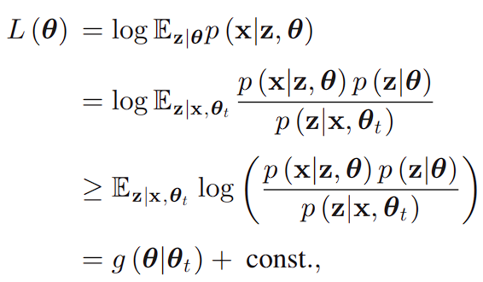
The EM Algorithm
Denote the observed variable by x and the latent variable by z
Note that
E-step:
M-step:
(Jensen’s Inequality)

Slide 14
Omitted frameworks
Cyclic Minimization
DC Programming and Concave-Convex Procedure
Proximal Minimization
Variable Metric Splitting Method for Non-Smooth Optimization
Successive Convex Approximation (SCA) Algorithms
Subspace MM Algorithm

Slide 15
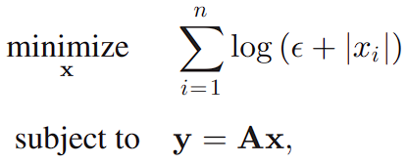
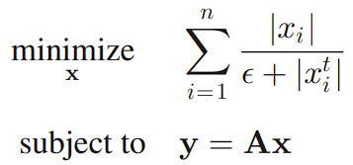
Application: First Order Taylor Expansion
A sparse solution of an underdetermined equation system
Reweighted L1-norm Minimization (at t iteration, Example 1)
E. J. Candes, M. B. Wakin, and S. P. Boyd, “Enhancing sparsity by reweighted L1 minimization,” J. Fourier Anal. Appl., vol. 14, nos. 5–6, pp. 877–905, 2008

Slide 16
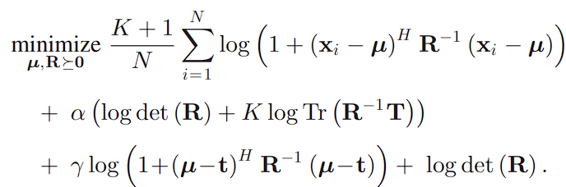
Application: Convexity Inequality
Mean-covariance estimation problem
Y. Sun, P. Babu, and D. P. Palomar, “Regularized robust estimation of mean and covariance matrix under heavy-tailed distributions,” IEEE Trans. Signal Process., vol. 63, no. 12, pp. 3096–3109, Jun. 2015

Slide 17
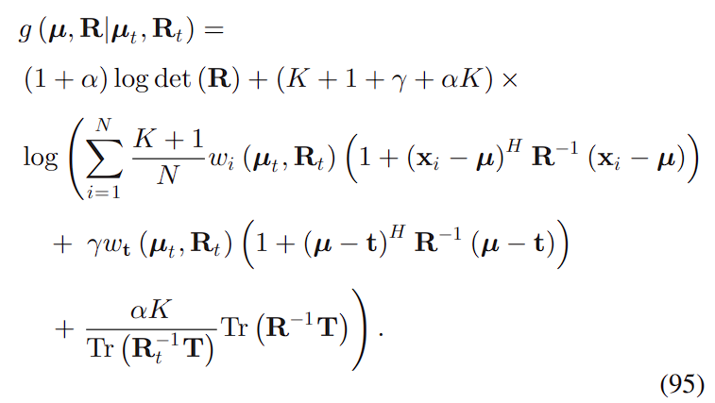
Application: Convexity Inequality
Applying the inequality of Example 5
Y. Sun, P. Babu, and D. P. Palomar, “Regularized robust estimation of mean and covariance matrix under heavy-tailed distributions,” IEEE Trans. Signal Process., vol. 63, no. 12, pp. 3096–3109, Jun. 2015

Slide 18
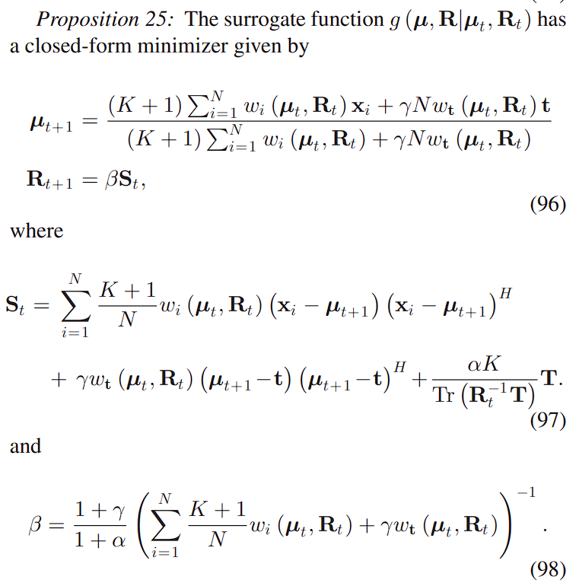
Application: Convexity Inequality
Y. Sun, P. Babu, and D. P. Palomar, “Regularized robust estimation of mean and covariance matrix under heavy-tailed distributions,” IEEE Trans. Signal Process., vol. 63, no. 12, pp. 3096–3109, Jun. 2015

Slide 19
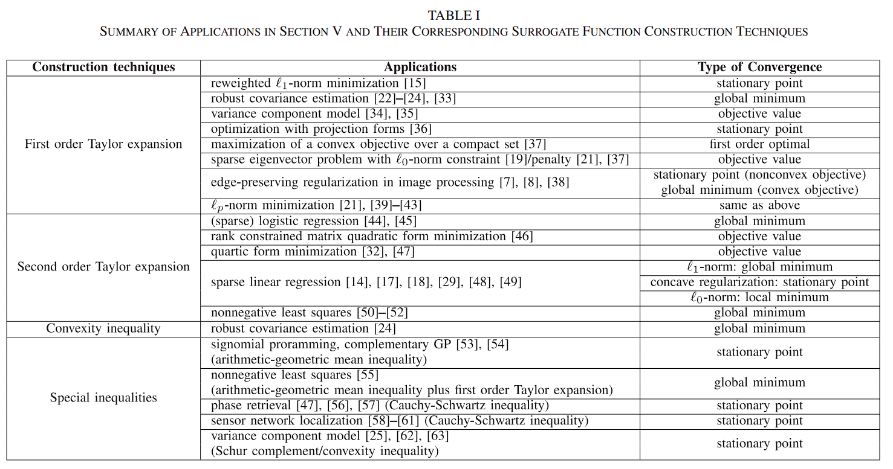
Application Table

